Slide 1
Beethoven, Bach, and Brahms in Bull/Bear Markets
The Influence of Economic Health on Music Selection at the Symphony
Mark Llorente

Slide 2
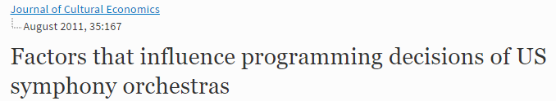
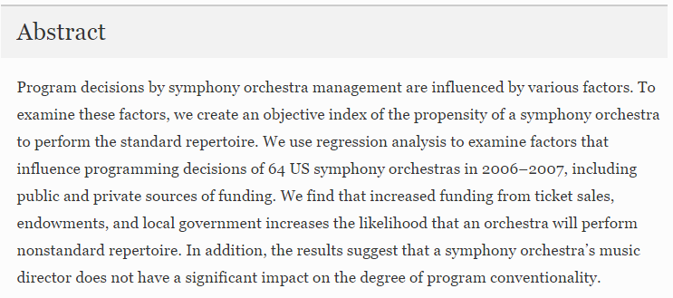

Background
Local and National Economic Health
Increased Funding for Arts/Money from Patrons
More Nonstandard Music

Slide 3
Data Sources
Symphony Selections
New York Philharmonic Program Database
Economic Indicators
National Endowment of the Arts Employment Data
Federal Reserve Indices
Federal Reserve Bank of New York Indices

Slide 4
Our Metric: Unconventionality
Program considered unconventional if it features infrequently performed composers and pieces
“Penalize” commonly performed works
“Penalize” regularly played seasonal works, e.g. Handel’s Messiah

Slide 5
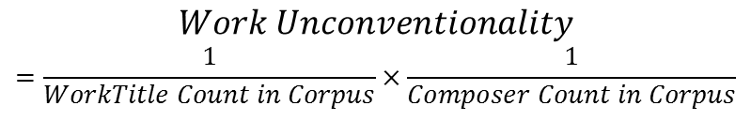


Our Metric: Unconventionality
$$Work Unconventionality$$
$$=\frac{1}{WorkTitle Count in Corpus}×\frac{1}{Composer Count in Corpus}$$
Unconventionality By Program
mean: 0.0055, median: 0.00005
std: 0.0186
min: ~0.0, max: 0.250
Unconventionality By Season
mean: 0.0081, median: 0.005076
std: 0.0084
min: 0.0003, max: 0.0047
$$Program Unconventionality=\frac{∑Work Unconventionality}{N_{works_in_program}}$$
$$Season Unconventionality=\frac{∑Program Unconventionality}{N_{programs_in_season}}$$

Slide 6
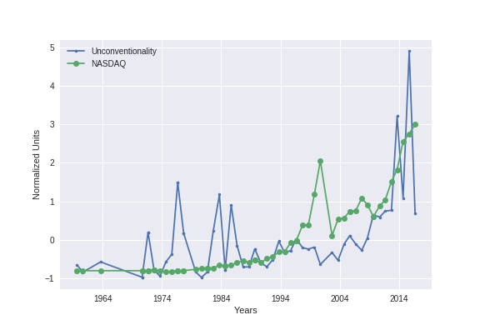
Economic Indicators and NY Phil Program Unconventionality at a Glance

Slide 7
Methods
Models:
Random Forest*
PCA Matrix Decomposition to Minimize Redundant Splits
Logistic Regression*
*Label of “True” if Unconventionality>Median
Model Validation
Time Series Split Instead of Cross Validation to Predict Forward in Time
Model Scoring
Recall, Precision, F1
Notes:
Linear Regression
Unconventionality and 1/Unconventionality as y-labels

Slide 8
Baseline Model vs Best Model
By Program |  |  | By Season
F1 | Recall | Precision | F1 | Recall | Precision
0.64 | 0.8 | 0.53 | 0.82 | 0.75 | 0.92
0.35 | 0.30 | 0.42 | 0.62 | 0.5 | 0.80
0.61 | 0.70 | 0.54 | 0.84 | 0.81 | 0.87
0.58 | 0.5 | 0.71 | 0.71 | 0.63 | 0.83
Baseline Logistic Regression
Baseline Random Forest
Logistic Reg with Change Over 28 Days
Random Forest with Change Over 28 Days

Slide 9
Conclusions
Season most relevant target for predicting conventionality
Changes in market affect conventionality
Δ28_Days NYC Coincident Economic Index Strongest Feature
Local matters!
Next Step:
Expand data to other symphonies

Slide 10
Thank You!
https://github.com/markcatalysis/ny_phil_selection

Slide 11
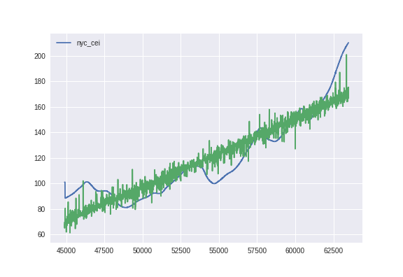
Is There Signal?
Notes:
New York City/State Coincident Economic Indicators as Labels
Counts for top Top 50 Composers
Counts for Top 1000 Pieces
Occurrence of “Small” Pieces with Smaller Orchestras (decrease overhead costs)
e.g: Concertos, Quartets, Ensemble

Slide 12
[('NASDAQCOM', 0.16310439568213458),
('DJIA', 0.044763522092463204),
('SP500', -0.26989548582145656),
('VIXCLS', 0.01235687064524414),
('FEDFUNDS', -0.91185609016088243),
(u'Total industry employment', 0.16818100040918132),
(u'Total industry compensation', 0.16818100040918088),
(u'ACPSA employment ratio', 0.16818100040918127),
(u'ACPSA compensation ratio', 0.16818100040918127),
(u'ACPSA employment', 0.16818100040918052),
(u'ACPSA compensation', 0.16818100040918066),
(u'Employment location quotient', 0.16818100040917869),
(u'Compensation location quotient', 0.16818100040918055),
('New York', 0.11239172951295938),
('NYC', 0.29660125689527428)]
[('NASDAQCOM', -0.064504261095416571),
('DJIA', -0.0087692295415448991),
('SP500', -0.35228683210836281),
('VIXCLS', 0.043248945404701443),
('FEDFUNDS', -1.1239890080714212),
(u'Total industry employment', 0.11708182767005224),
(u'Total industry compensation', 0.11708182767005244),
(u'ACPSA employment ratio', 0.11708182767005214),
(u'ACPSA compensation ratio', 0.11708182767005214),
(u'ACPSA employment', 0.11708182767005279),
(u'ACPSA compensation', 0.1170818276700521),
(u'Employment location quotient', 0.11708182767005053),
(u'Compensation location quotient', 0.11708182767005172),
('New York', -0.38049270432226601),
('NYC', 0.043838845747589651),
('NASDAQCOM_delta_28_days', -0.47321315514966295),
('DJIA_delta_28_days', 0.21287591765672692),
('SP500_delta_28_days', 0.02051316790707253),
('VIXCLS_delta_28_days', -0.46754110429464307),
('FEDFUNDS_delta_28_days', -0.22832660519234485),
(u'Total industry employment_delta_28_days', -0.11708182767005286),
(u'Total industry compensation_delta_28_days', -0.11708182767005287),
(u'ACPSA employment ratio_delta_28_days', -0.11708182767005268),
(u'ACPSA compensation ratio_delta_28_days', -0.11708182767005268),
(u'ACPSA employment_delta_28_days', -0.11708182767005239),
(u'ACPSA compensation_delta_28_days', -0.11708182767005272),
(u'Employment location quotient_delta_28_days', -0.11708182767005226),
(u'Compensation location quotient_delta_28_days', 0.11708182767005326),
('New York_delta_28_days', 0.055523169407802837),
('NYC_delta_28_days', 0.93721441667859151)]

